Slide 1

Shield Insurance
Financial Risk Protection

Slide 2



Data And Tool Used
Source File
Tool Used
The analysis is based on five structured CSV files: Customer, Date, Policies, Premiums, and Settlements
Power BI and Power Query were used to transform data, build the data model, create DAX measures, and develop interactive dashboards.

Slide 3
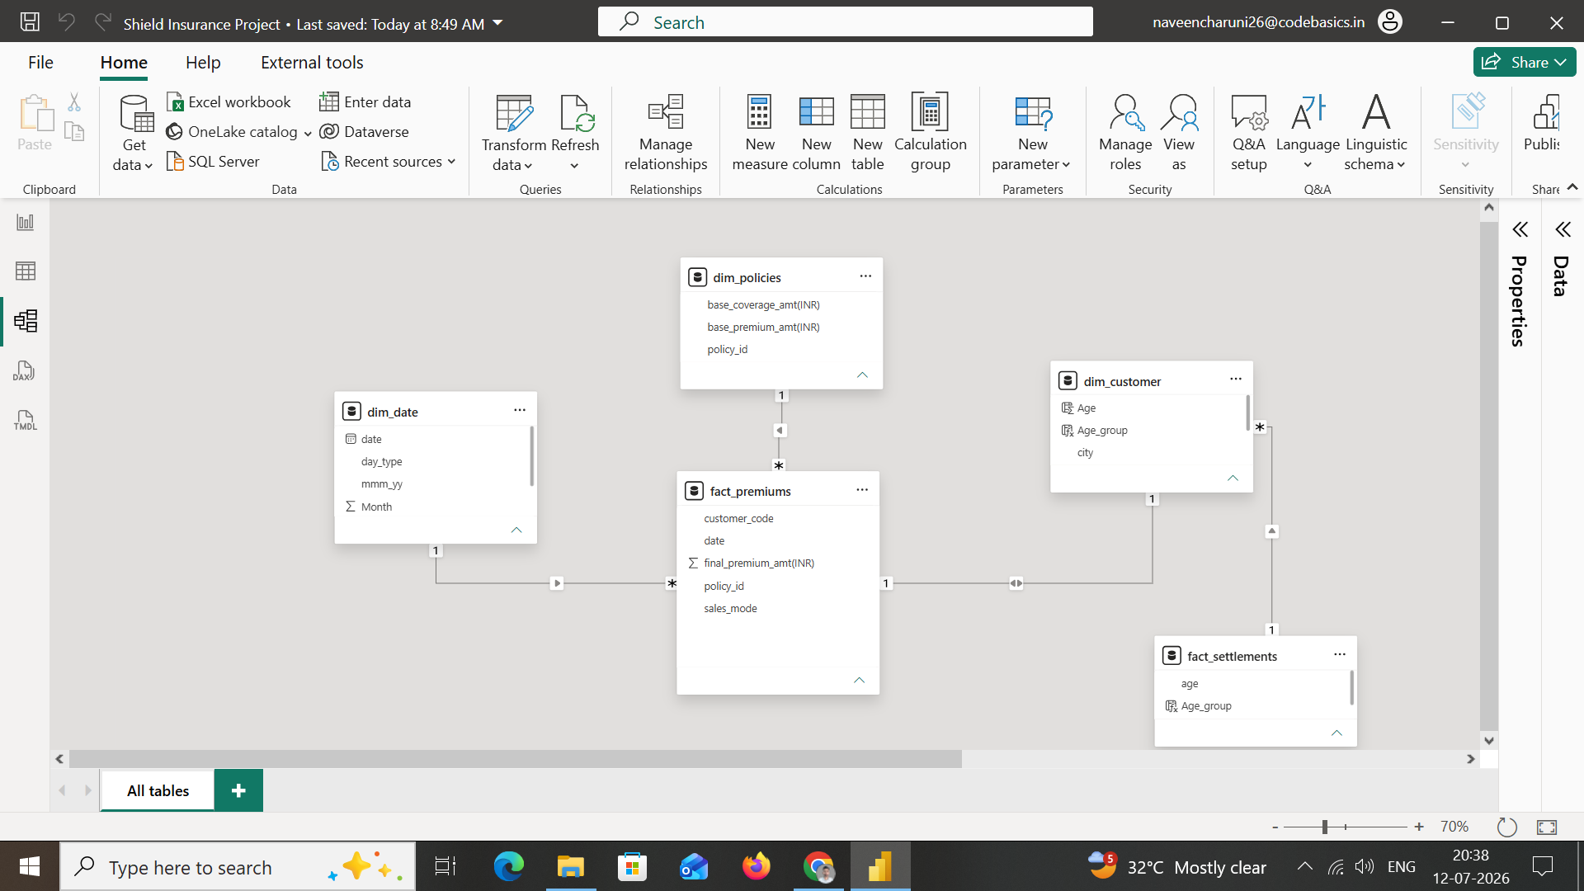
Data Modelling

Slide 4
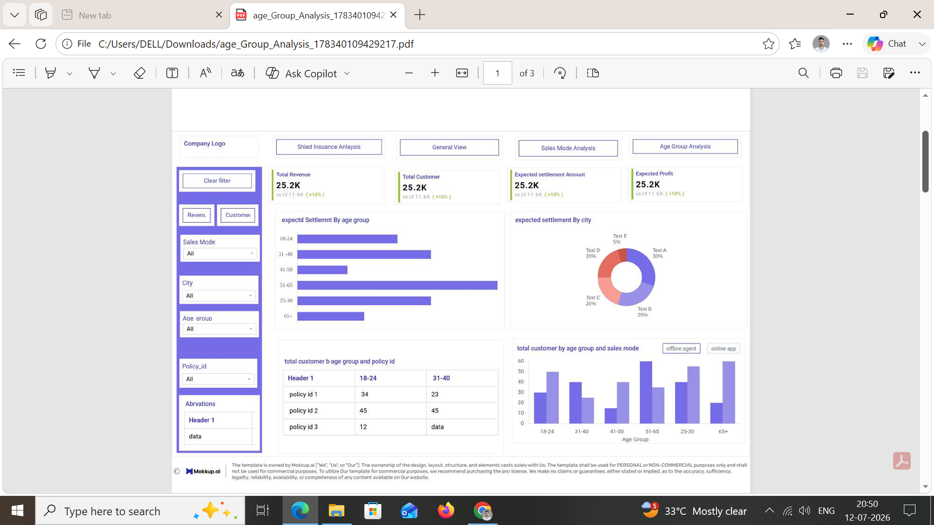
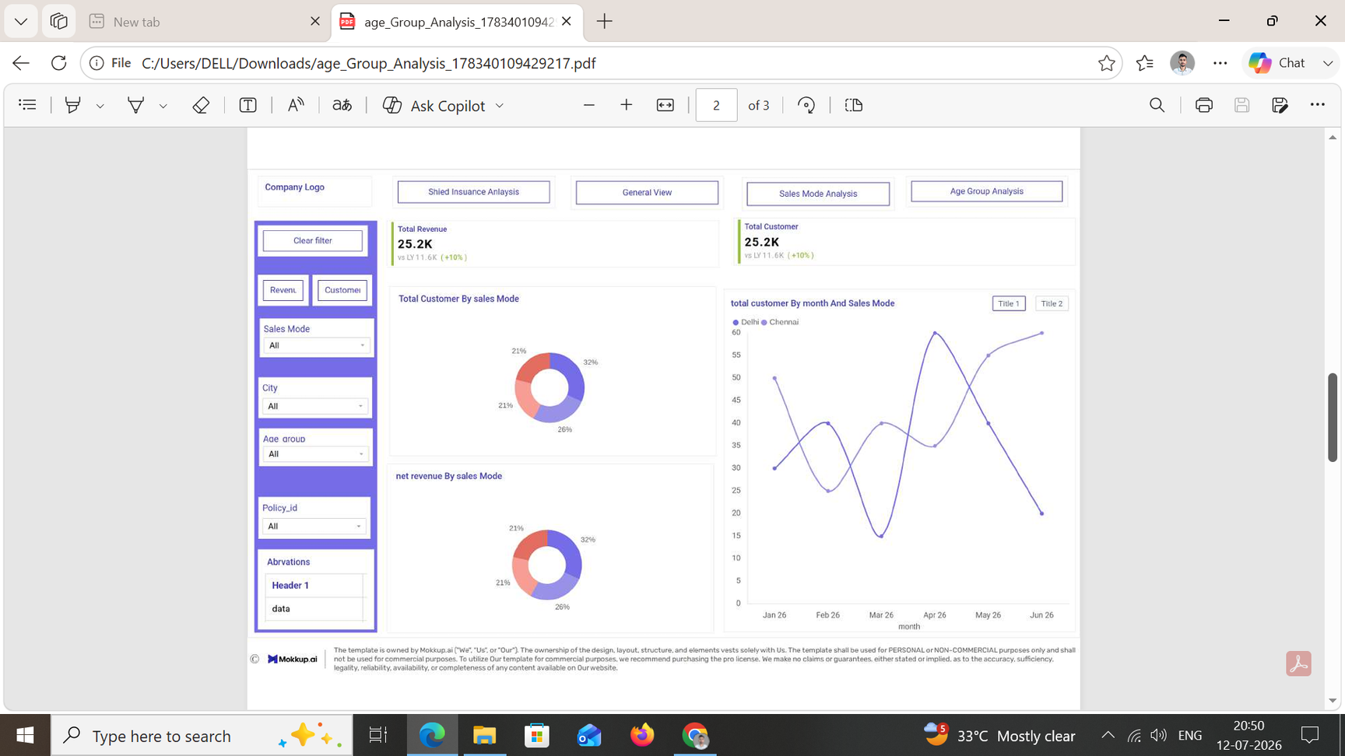
Project Mockup Design

Slide 5
Client Requirements Summary
Core metrics – Track total number of customers and total revenue.
Growth rates – Monitor daily revenue growth rate and daily customer growth rate.
Policy trends – Track month-over-month changes in policies to spot trends and improvement areas.
Segmentation – Segment customers by age group, and analyze revenue and customer numbers by city and age group.
Trend graphs – Provide a toggle/switch between revenue trend and customer trend graphs over time.
Filters – Include filters for sales mode, age group, city, month, and policy ID for efficient analysis.
Sales mode analysis (separate page) – Show total customers and revenue split (%) by sales mode, plus month-wise sales mode trends.
Age group analysis (separate page) – Analyze expected settlement, sales mode, and policy preference by age group to support business decisions.

Slide 6

Thank You
Business Insights Through Data Analytics
Presented By
Naveen Jhinjarye

